Slide 1
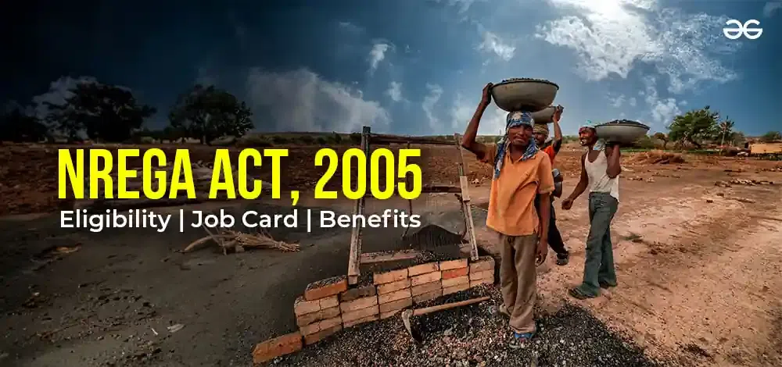
NREGA
NREGA ANALYSIS IN POWER BI
Batch Name: MIP-DA-09
BANDARU LALUPRASAD

Slide 2
INTRODUCTION
NREGA/MGNREGA - National Rural Employment Guarantee Act. The National Rural Employment Guarantee Act (NREGA) was introduced by the Government of India (GOI) in the year 2005. The act’s name was eventually changed to Mahatma Gandhi National Rural Employment Guarantee Act (MGNREGA).
The Mahatma Gandhi National Rural Employment Guarantee Act (MGNREGP) is a social security scheme. The scheme was introduced with a purpose of enhancing the standard level of living of the rural household and they stopped migrating toward the city. The objective of this study was analysing the suggestions given by the MGNREGA beneficiaries in their work and work site.

Slide 3
ABSTRACT:
This project delves into the analysis of data related to the National Rural Employment Guarantee Act
(NREGA), a transformative government scheme to provide rural households with guaranteed
wage employment opportunities. The dataset used for this analysis encompasses a wide range of
parameters, including the number of job cards issued, the workforce engaged, budget allocation, work
completion statistics and much more. By applying data analytics techniques, we aim to
gain valuable insights into the implementation and impact of NREGA across different states and districts
in India.

Slide 4
DATASET INFORMATION:
The dataset used for this analysis is sourced from official government records and contains information related to NREGA implementation across various states and districts in India. It comprises 28 columns, encompassing data on job cards, worker details, budget allocation, work completion statistics, expenditure, and more. This dataset offers a comprehensive view of the progress and challenges faced by the NREGA program.

Slide 5
SCOPE:
This project aims to analyze and visualize the NREGA dataset to extract meaningful insights.
The scope includes:
Data preprocessing and cleaning to ensure data quality.
Exploratory data analysis (EDA) to identify patterns, trends, and disparities in NREGA implementation.
Utilizing data visualization techniques to present key findings effectively.
Drawing actionable insights to inform policymakers and administrators about the strengths and weaknesses of the NREGA program.

Slide 6
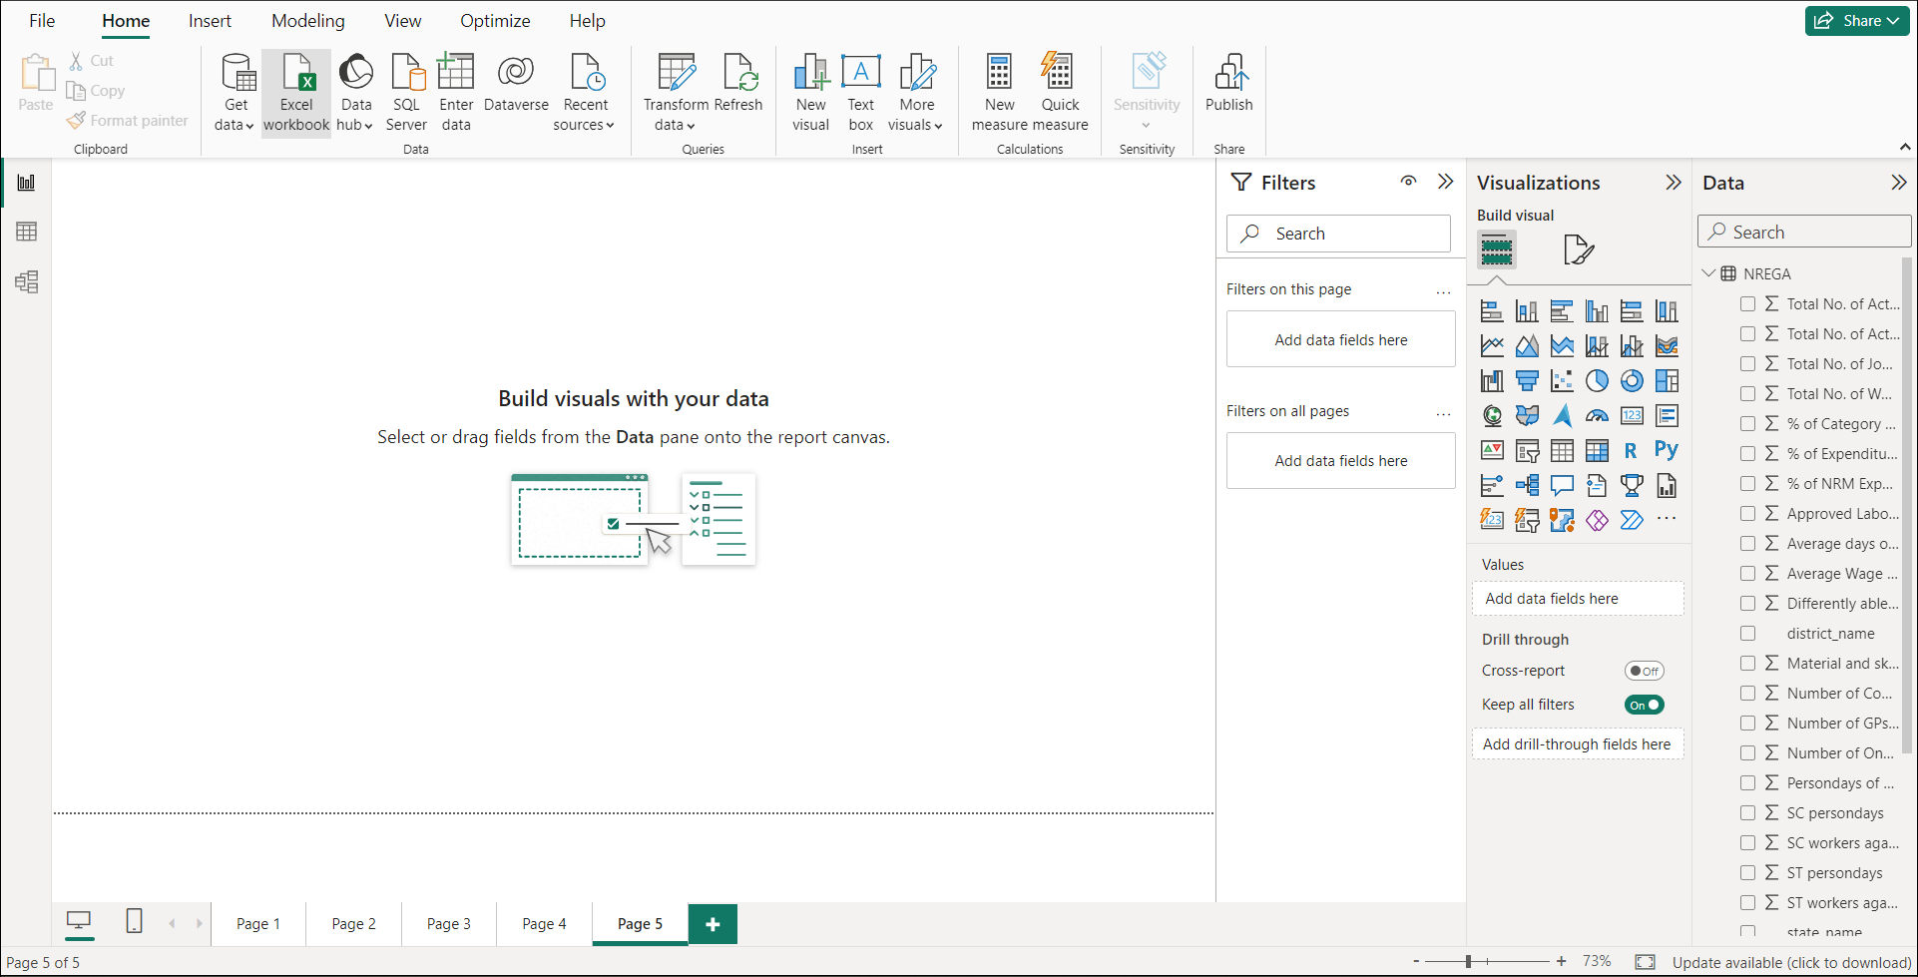
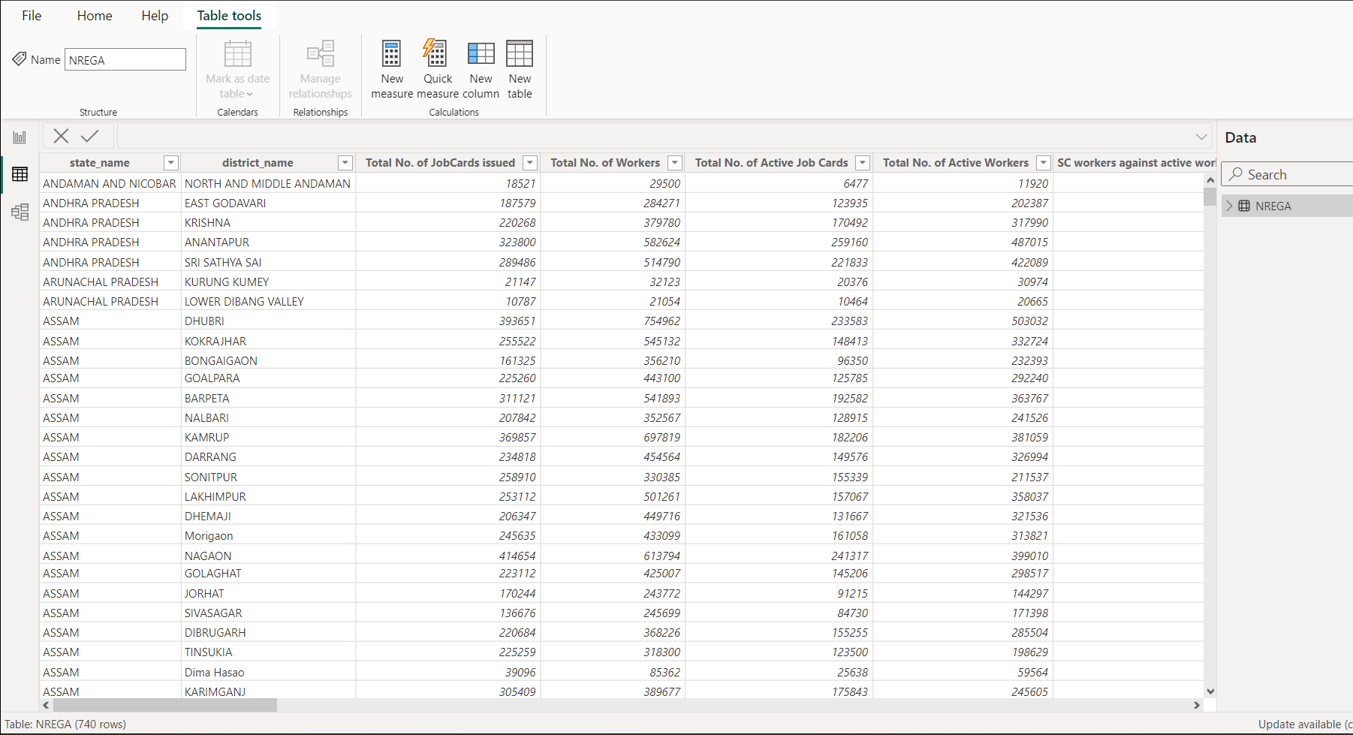
IMPORTING THE DATA

Slide 7
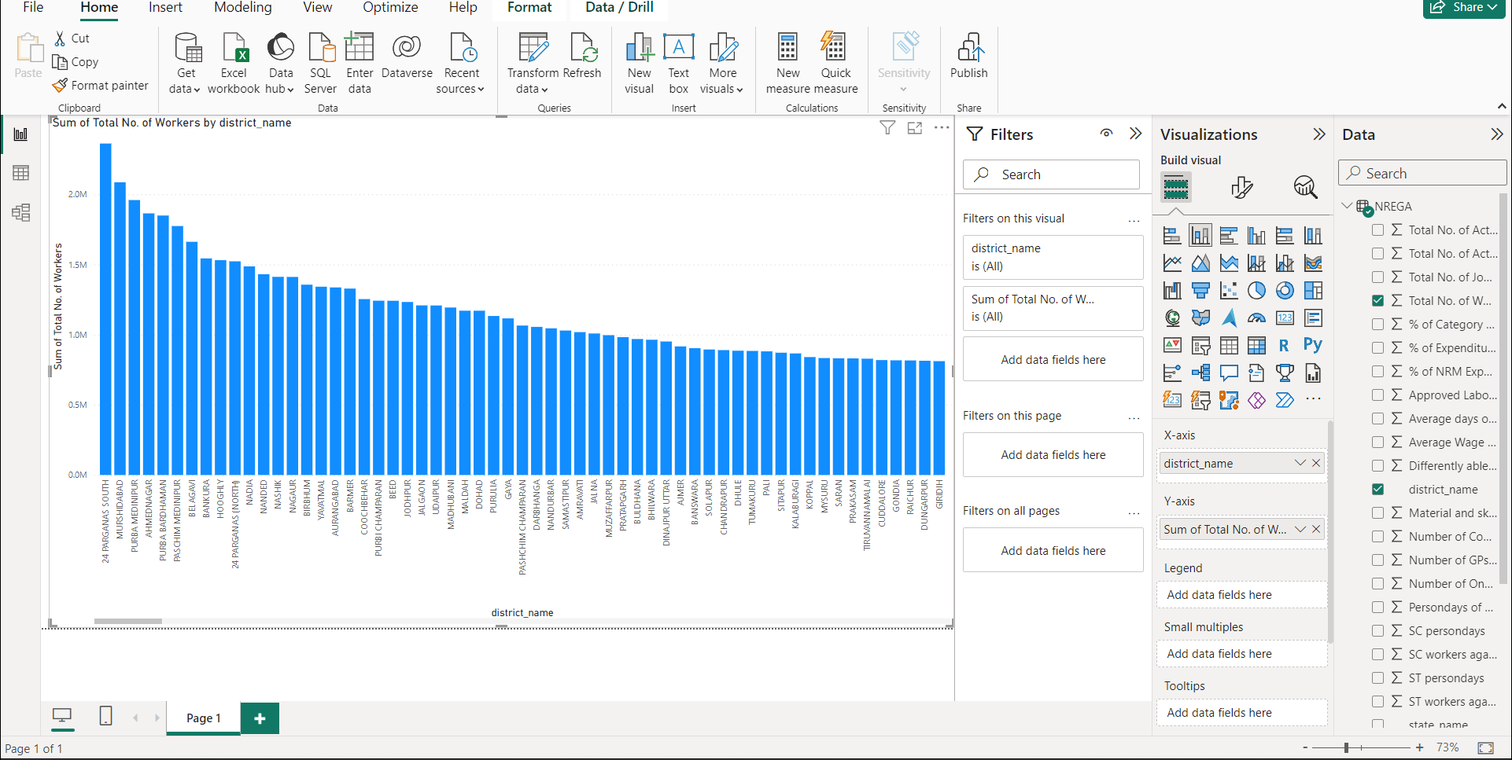
NREGA has empowered women and marginalized sections of society by providing them with access to wage employment and enhancing their socio-economic status. Migration Control: NREGA has helped in controlling distress migration by providing alternative livelihood opportunities in rural areas.

Slide 8
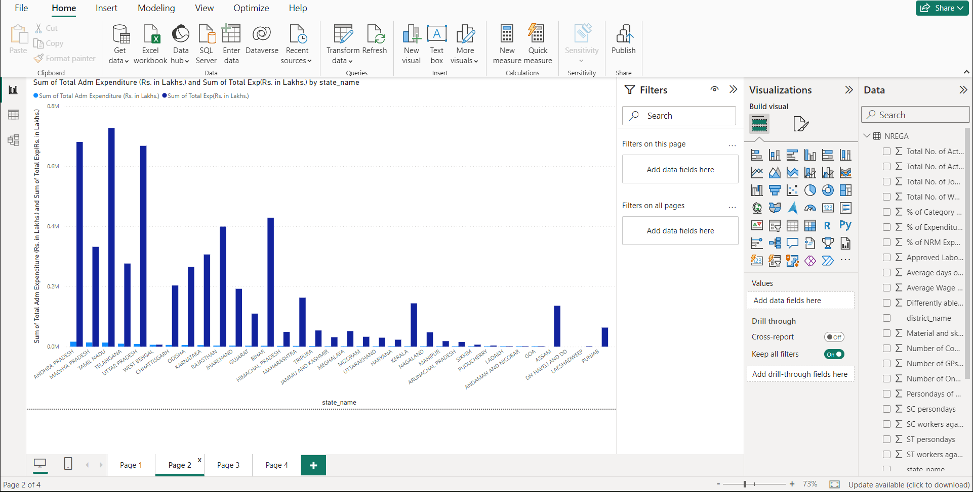
First, there is significant variability in the implementation and uptake of MGNREGA across various states (Khera, 2011). Key to implementation is the availability of work. On average, the number of days available for work has been lower than that guaranteed by the Act.

Slide 9
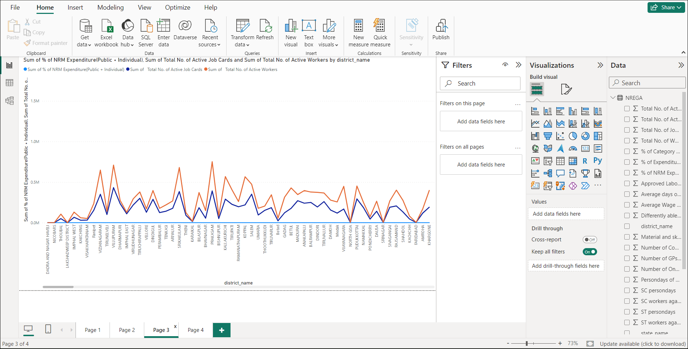
With the allocation of ₹86,000 crore for the Mahatma Gandhi National Rural Employment Guarantee Scheme (MGNREGS), the budget for the scheme for the financial year 2024-25 has been hiked by ₹26,000 crore in comparison to the 2023-24 Budget estimates, though it is the same as the revised estimates for the ongoing financial. The analysis shows that there is an increase in employment generation under the MGNREGA scheme during covid 19in rural areas and the reason is a migration of rural people from urban areas. The statistics also portray that there is a continuous increase in the wage rate system under MGNREGA. The main idea of MGNREGA is to scrutinize the reliability and success of the employment policy.

Slide 10
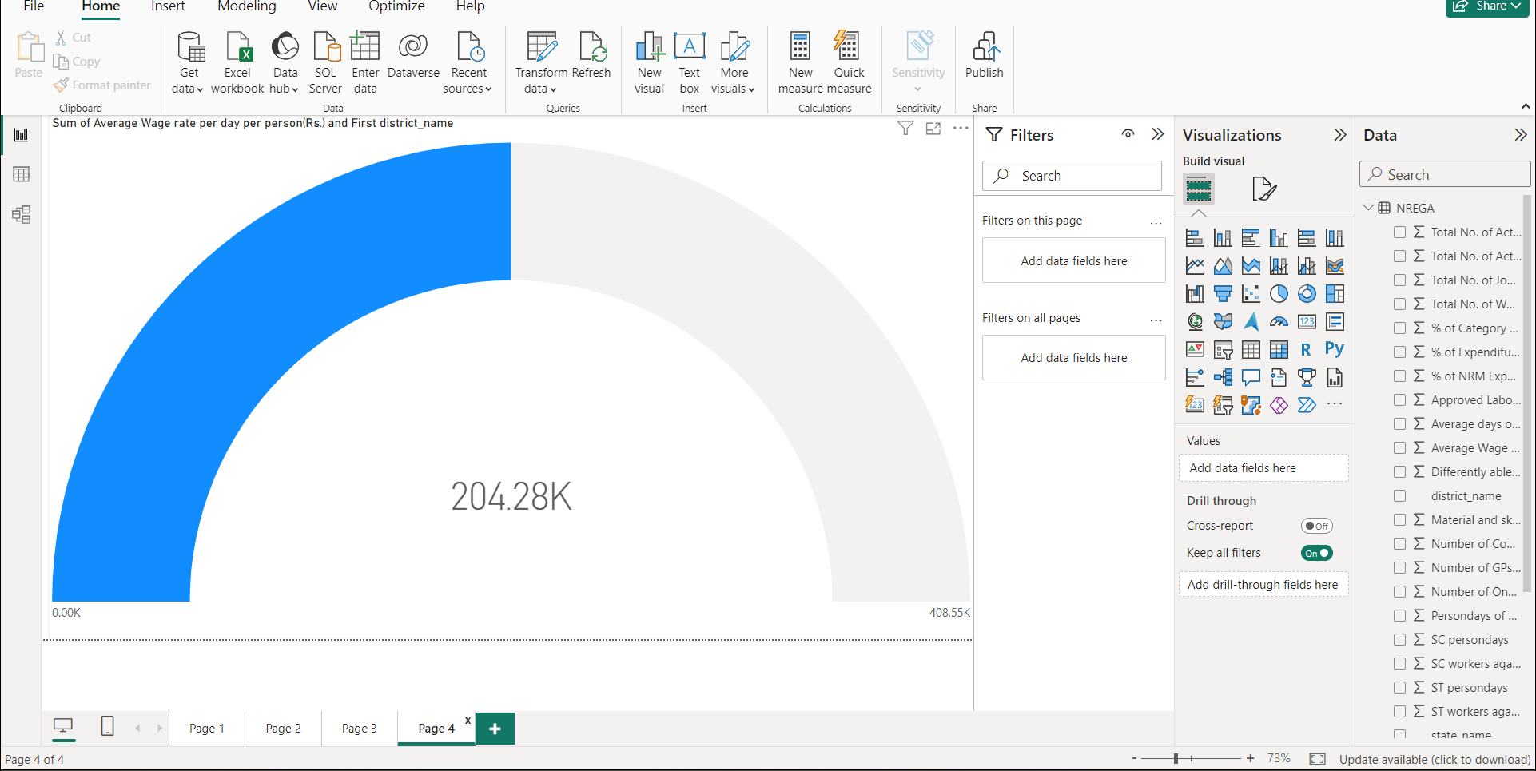
Given that the available budget is known to be a key determinant for the success of any programme it is noteworthy that under MGNREGS, insufficient financial support has been identified as the major barrier to providing at least 100 days of employment to every rural household

Slide 11
DATA-DRIVEN INSIGHTS
The data insights help in identifying key issues, understanding the potential impacts of different policy choices, and assessing the feasibility and effectiveness of proposed interventions.
Policy Implementation: After policy formulation, the chosen policy initiatives are put into action.

Slide 12
SUGGESTIONS
Finally the study concluded that the most important suggestions given by the MGNREGA beneficiaries were The MGNREGA provide equal wages to market wages & Timely payment of wages ranked first with Garrett’s mean score of 63.8, followed by Available work needed time with Garrett’s mean score of 60.36.
Hence the study suggests making suitable efforts to increase awareness and make a bridge between MGNREGA Scheme and MGNREGA beneficiaries. This study helps new and young researcher who wants to do research in this area may helpful to them to recognize the research issue and research gap.

Slide 13
THANK YOU

